Slide 1
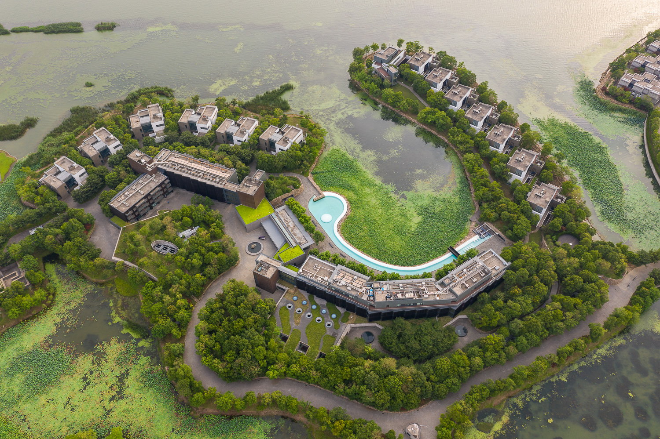
INAUGURAL WELLESLEY ASIA ALUMNAE RETREAT FORUM 2026
May 1 – 3
Notes:
https://bit.ly/wellesleyforum

Slide 2
PROGRAMME
Day 1: May 1, Friday
2.00pm - Arrival and registration
5.00pm - Introduction to Sangha and tour of facilities
6.30pm - Gather at the Village for program orientation and welcome greetings
7.00pm - Dinner at Sangha’s Market Place | Catchup with old and meeting with new
Day 3: May 3, Sunday
9.00am – Business, Finance & Enterpreneurship
Opening Comments by Lulu WANG
Moderator – Sui Ling CHEAH
Panelists :
  ~ Lulu WANG
  ~ Jiwon WOO
  ~ Hefei Wang
  ~ CHANG HaeJin
10.30am - Tea Break
11.00am - Stories: Wellesley Women’s Life Journeys Through The Generations
Moderator – Mary Ann TSAO
Panelists –
~ Nelly FUNG
~ Anne CHAO
~ Edie HU
~ Jocelyn WONG
12.00pm – Closing by Mary Ann TSAO
Day 2: May 2, Saturday
12.30pm - Lunch break
1.30pm – Health & Care
Opening Remarks by Paula JOHNSON
Moderator – Sarah KOCHLING
Panelists :
  ~ Paula JOHNSON
  ~ Sarah KOCHLING
  ~ Sophia ZUO QIU
  ~ Yang CHEN
3.00pm – Tea Break
3.30pm – Art & Culture
Opening Remarks by Mee Seen LOONG
Moderator – YAO Mingji
Panelists :
~ Judy GEE
~ Mee Seen LOONG
~ Lulu WANG
~ CHUNG Hyun Min
5.00pm - Conclude Day 2
6.30 - Depart for Su cuisine dinner in Suzhou town
Day 2: May 2, Saturday
9.30am – Opening
MC – Jiezhen WU
Keynote by Paula Johnson
  Wellesley Update & Women’s educational needs today and impact of a Wellesley education
Anne Chao – Trustees’ Welcome
10.30am - Tea Break
11.00am – Philanthropy & Impact
Opening Remarks by Mary Ann Tsao
Moderator - Mary Ann Tsao
Panelists :
~ Lulu WANG
~ Anne CHAO
~ Cindy KO

Slide 3
ABOUT
SPEAKERS
Anne CHAO ‘74
Dr Anne Chao is a lecturer in Humanities at Rice University. She is a member of the advisory boards of Rice University’s Center for the Study of Women, Gender, and Sexuality, Chao Center for Asian Studies, School of Humanities, the Kinder Institute for Urban Research, the Shepherd School of Music, and a member of the Patron Group of the Moody Arts Center. She also serves on the governing boards of the Houston Ballet, the Houston Endowment, the Museum of Fine Arts, Houston and the Dunhuang Foundation.
CHANG Hae Jin
HaeJin Chang is Director of the New Business Development Team where she leads initiatives to identify emerging market opportunities and develop them into scalable, sustainable businesses beyond the company’s existing portfolio. She began her career in Korea in public relations and communications, managing PR and communications for CNN Seoul and Cartoon Network. She later earned her MBA from the Wharton School of the University of Pennsylvania, where she deepened her interest in the fashion and beauty industry.
CHUNG Hyun Min ’75
In 2012, The Korea Herald reports that Chung Hyung-min, the sixty-one-year-old director of the Seoul National University Museum of Art, was named director of the National Museum of Contemporary Art in Seoul. Chung received her Ph.D. in art history from Columbia. She has been teaching art at Seoul National University since 1994 and acting as exhibition director of Seoul Arts Center since 1999.
Cindy KO
Cindy is the head of Catalytic Investment Partnerships, an impact investment advisory firm specializing in investing in nature and climate positive businesses. She was Head of the Asia Pacific region for Toniic, a global community of asset owners seeking deeper positive net impact across the spectrum of capital. Cindy has served as an independent director for JcbNext and worked as Head of Asia for not-for-profit organisation Endeavor. Passionate about social impact, Cindy is concerned with aligning wealth with values.
Edie HU ‘97
Open-water marathon swimmer Edie Hu was the first woman in 42 years to swim the English and Catalina channels, the Strait of Gibraltar and the 20 Bridges Manhattan Island circumnavigation (the latter three constituting the Triple Crown). Hu has also been involved in Splash, a charity aimed at spreading swimming literacy and for which she now serves an ambassador, since 2015. Her ambitions include swimming the North Channel from Scotland to Ireland, New Zealand’s Cook Strait and the Molokai Channel in Hawaii.
Hefei WANG
Dr. Hefei Wang is Deputy Dean and Professor of Finance at the International Business School Suzhou (IBSS), Xi’an Jiaotong-Liverpool University. Prior to joining IBSS, she was Professor of Finance and Director of the Financial Big Data Lab at Renmin University of China. She also held the position of Associate Professor of Finance at the Hanqing Advanced Institute of Economics and Finance at Renmin University of China. Dr. Wang’s research focuses on theoretical corporate finance, dynamic asset allocation, and financial big data.
Jiezhen WU
Jiezhen is a Senior Principal with Korn Ferry Advisory in the CEO & Board Practice, based in Singapore. She is a trusted leadership coach and advisor committed to building a more conscious world by helping individuals, teams, and organisations find the clarity and courage to lead across complexity and change. Jiezhen holds degrees from Harvard University and Wellesley College, a graduate degree in Positive Psychology, and is a certified yoga teacher, Deep Time Walk Guide, and Positive Psychology and Possibility Coach.

Slide 4
Jiwon WOO ‘10
Jiwon is the executive director and head of the Digital Division at Sindoh (South Korea), where she leads transformation initiatives spanning Al, brand strategy, and new business development. Jiwon has a multidisciplinary background bridging engineering, design, and business. She previously held professorships at New York University's Department of Media, Culture, and
Communication and the University of Pennsylvania's Department of Art and Design.
Jocelyn WONG ‘18
Jocelyn’s academic journey has been shaped by all-women institutions—from a school in Hong Kong to a boarding high school in Massachusetts, and finally to Wellesley where she traded competitive swimming for rowing. She led the Chinese Students Association and United Nations Girls' Foundation, igniting a commitment to community building, philanthropy, and women's empowerment that continues today through her leadership role with the Hong Kong Alumnae Club. Her professional background spans law and policy.
Judy GEE ‘96
Judy Gee is a Taiwanese-American painter based in Hong Kong. She holds a B.A. with honors in Studio Art and Economics, completing a thesis in painting from Wellesley College and an M.S. in Communications Design from Pratt Institute in New York. Her paintings exist somewhere between reality, memories and imagination by using distinctive visual language of saturated colors, dramatic contrasts creating images that exist but don‘t.
ABOUT
SPEAKERS
Lulu WANG ’66
Lulu Wang is a pioneering Wall Street investor, CEO of Tupelo Capital Management, and a major philanthropist deeply tied to Wellesley College. She is best known for her generous support of women's education, famously gifting $25 million with her husband, Tony, to fund the Lulu Wang Campus Center. She is recognized for advancing women in business and philanthropy, often advising alumnae to "do good by doing well".
Mary Ann TSAO ‘75
Dr Mary Ann Tsao is the Chair of the Tsao Family Office, which aims to deploy all its assets for impact through their investments and philanthropy. She is also the Vice Chair for the newly established Tsao Family Foundation as well as the Chairwoman and Founding Director of the Tsao Foundation, a Singapore-based, but regionally oriented operational foundation. Dr Tsao is currently a Board Director of Lausanne-based Family Business Network International (FBNI) as well as a trustee for Wellesley College, her Alma mater.
Mee Seen LOONG
After more than 40 years at Sotheby’s, Mee-Seen Loong has joined the Beijing-based Chinese ink art gallery INK Studio, where she held the position of director. Most recently a vice chairman at Sotheby’s New York headquarters, Mee Seen is also responsible for founding the auction house’s contemporary Chinese ink art department. She is a pioneering and legendary figure in the World of Chinese art. Her engagement with and expertise in Chinese ink painting has brought the emerging Chinese ink to the centre of the global art conversation.

Slide 5
Nelly FUNG ‘63
Cornelia (Nelly) Lichauco Fung is the eldest daughter of the late Philippine Ambassador Marcial Lichauco and his Cuban-American wife, Jessie Coe. Nelly Fung has lived in Hong Kong for over forty years. During that time her work in the community led her to be one of the founders of the Hong Kong International Music and Arts Festival which subsequently led to the formation of the HK Arts Festival. She was the Executive Director of the Society for the Promotion of Hospice Care and is a member of the Maryknoll Medical and Welfare Association.
Paula JOHNSON
Paula Adina Johnson is an American cardiologist and the current president of Wellesley College. She is the first Black woman to serve in this role. Prior to her role as president of Wellesley, Paula founded and served as the inaugural executive director of the Mary Horrigan Connors Center for Women's Health & Gender Biology, as well as Chief of the Division of Women's Health at Brigham and Women's Hospital. She was also Professor of Epidemiology at the Harvard T.H. Chan School of Public Health.
Sarah KOCHLING
Sarah Kochling is the Founder and Managing Principal of Shanghai Blossom Innovation, where she has led strategic growth initiatives for global brands and startups in China since 2014. With over 30 years of experience across Asia, she is a trusted advisor to Fortune 500 companies and early-stage ventures, guiding brand transformation, innovation strategy, and culturally attuned consumer engagement. Sarah is based in Shanghai, China. She studied Mandarin and Political Science at Wellesley College and holds certifications in Chinese language and law from MIT Sloan.
ABOUT
SPEAKERS
Sophia ZUO QIU
Associate Professor at the Pittsburgh Institute of Sichuan University, Sofia also holds the titles of Distinguished Expert of Sichuan Province, High-Level Overseas Returned Scholar, Expert supported by national “Double First-Class” discipline construction funding. She earned her doctorate from the Department of Environmental Health, Harvard T.H. Chan School of Public Health, Harvard University (USA), and her master’s degree from the Department of Global Health and Population at the same institution.
Sui Ling CHEAH
Sui Ling is Executive Chairwoman of a circular packaging startup for the wine and spirits industry called ecoSPIRITS as well as Venture Partner with Wavemaker Partners, a VC firm in Singapore focusing on early-stage tech investments. In addition, she sits on the investment committees of various regional funds in South East Asia. Sui Ling also holds board directorships at several private and publicly-listed companies in Singapore. She previously spent 15+ years in the investment banking industry.
Yang CHEN ’04
Chen Yang is founder of Red Fields Group, which invests in healthcare industry, trades commodities and provides advisory to companies globally. As Founder and Chairperson of Popular Line Medical Group, and as Chairperson of Sino-Israeli Health Alliance, he led the acquisition of a leading team in compact particle therapy, set up manufacturing in China, and ran global finance and strategy for the group. She is also President of Wellesley Club of Beijing and a Board Member of the Wellesley Business Leadership Council.
YAO Minji ‘06
Yao Minji is the Chief features reporter, Head of Business Reporting, Shanghai Daily. She is also the Cultural liaison and coordinator for cross-region projects. Minji worked extensively on cross-cultural projects that involve both Chinese and foreign studios, including China Film Group Corp. Disney Studio, CNN, BBC, among others. She was guest on TV projects including Anthony Bourdain’s “Parts Unknown” as well as judged for for Shanghai International Film Festival’s Silk Film Week

Slide 6
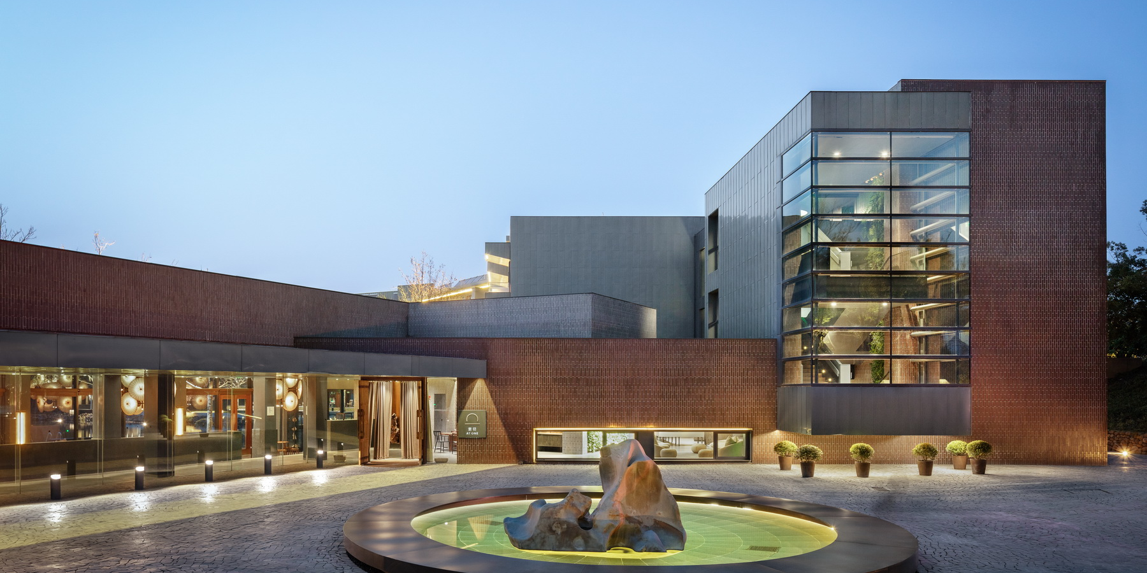
ABOUT SANGHA
Located in a beautiful corner of Yangcheng Lake Peninsula, within an area of 189,000 square meters, SANGHA Retreat by OCTAVE is an external urban retreat and living community which integrates Eastern wisdom and Modern science to provide a new comprehensive wellness experience. The brainchild of visionary Chavalit Frederick Tsao, SANGHA invites guests to become fully immersed in their personal well-being evolution, through individually curated programs addressing the eight living habits of Breathing, Eating, Movement, Sleeping, Stillness, Worldview, Middleway and Celebration of Life, so as to enhance their inner awareness, connect with like-minded partners and seek the true meaning of life together.
www.octaveliving.com/sangha-retreat-by-octave/

